Slide 1

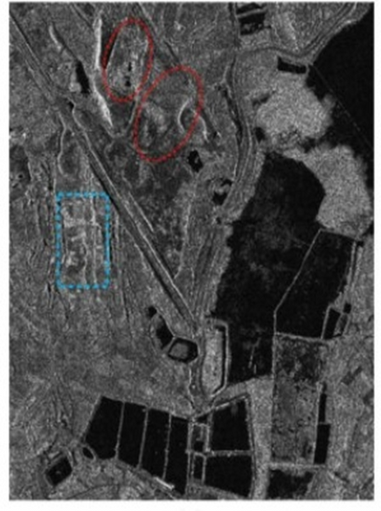
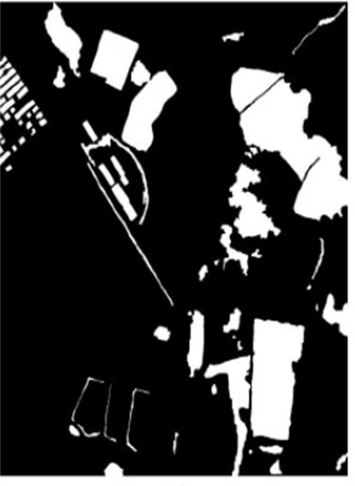
CHANGE DETECTION IN REMOTELY SENSED IMAGES
MTP PRESENTATION
PREPARED BY-
PRIYA DAS
23M0315
GUIDED BY-
PROF BIPLAB BANERJEE
https://www.pantechsolutions.net/wp-content/uploads/2021/09/sar_image_change_detection.jpg

Slide 2
CONTENT
Vision Transformer
Swin Transformer
Result Analysis
A hierarchical Vision Transformer (ViT) model using a 4×4 patch-based encoder and a custom-designed decoder.
Hierarchical ViT with shifted window attention encoder for efficient local-global feature extraction ,combined with a custom-designed decoder
Comparison of Results Across Architectures and Dataset Sizes

Slide 3

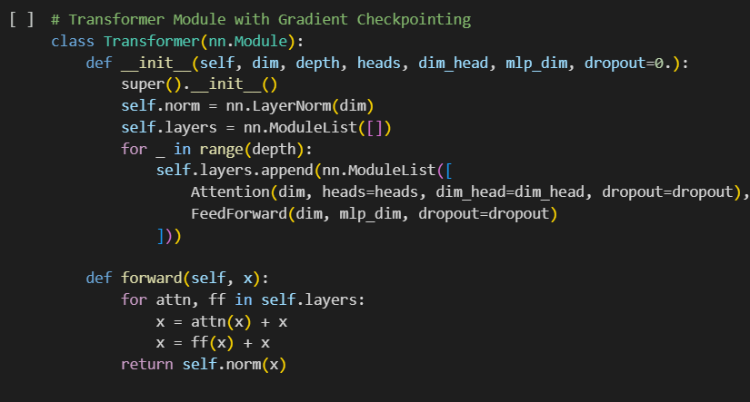
VIT ENCODER
H/4 * W/4 * C1
H/8 * W/8 * C2
H/16 * W/16 * C3
H/32 * W/32 * C4
VIT Block
VIT Block
VIT Block
VIT Block
Downsampling
Downsampling
Downsampling
Position Embedding
MLP
MLP
Patch Embedding
MLP
1
1
3
1
Stage 1
Stage 2
Stage 3
Stage 4
H=256, W=256
C=64
patch_size=4

Slide 4
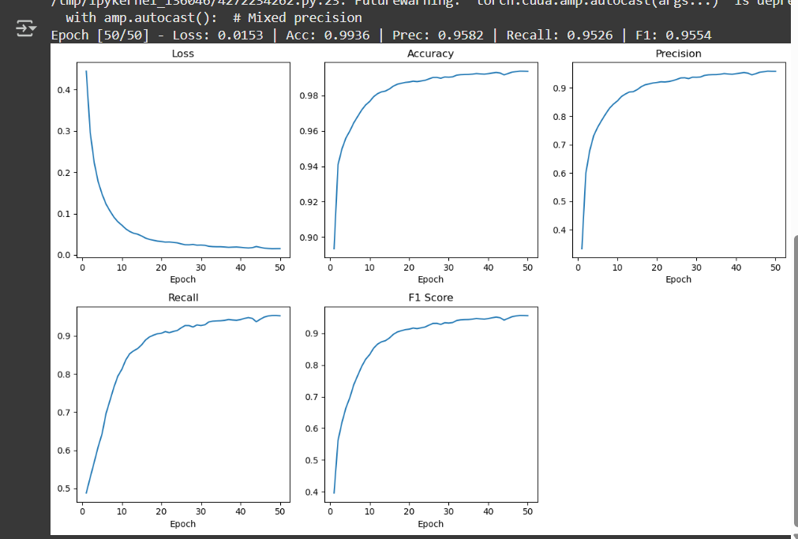
RESULTS
Vision -Transformer DataSize(1/4)
Dataset Used- LEVIR-CD

Slide 5
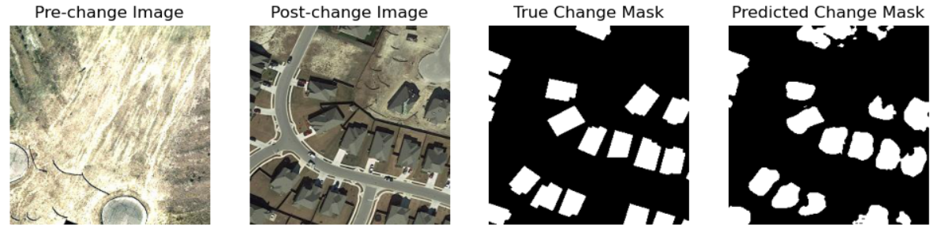
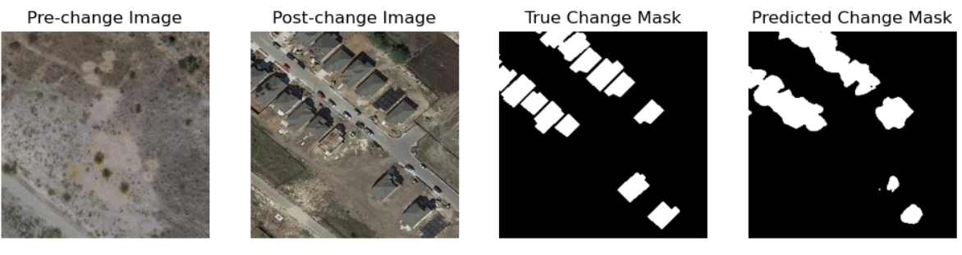
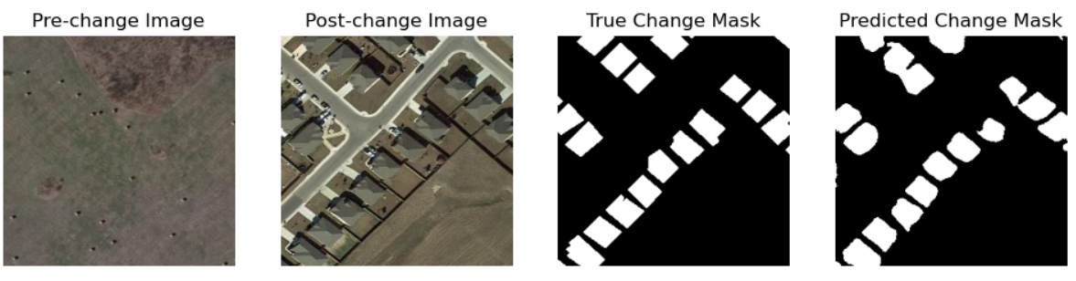
RESULTS
Vision -Transformer DataSize(1/4)

Slide 6
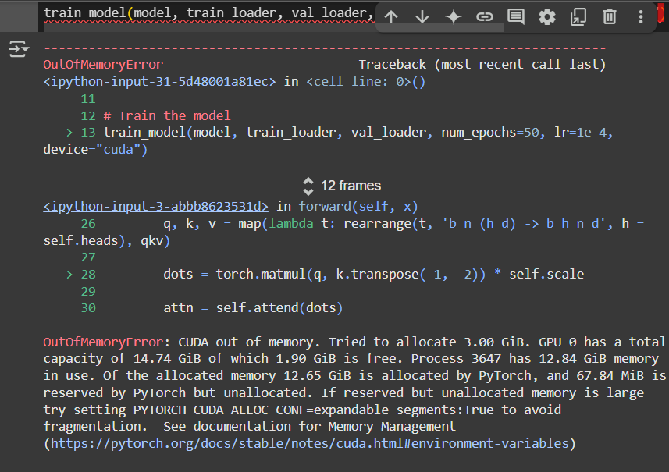
CHALLENGES WITH VIT
Inductive Biases
Lacks inductive biases like locality and translation equivariance
Data-hungry
Requires large datasets to learn spatial relationships
Computationally Expensive
Global attention is computationally expensive, of order O(N²), where N = number of patches

Slide 7
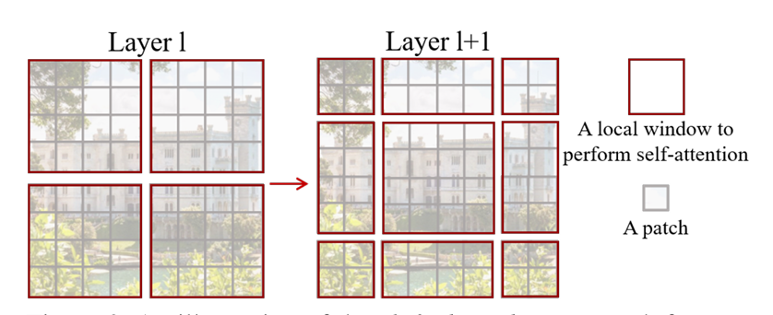
SWIN TRANSFORMER

Slide 8
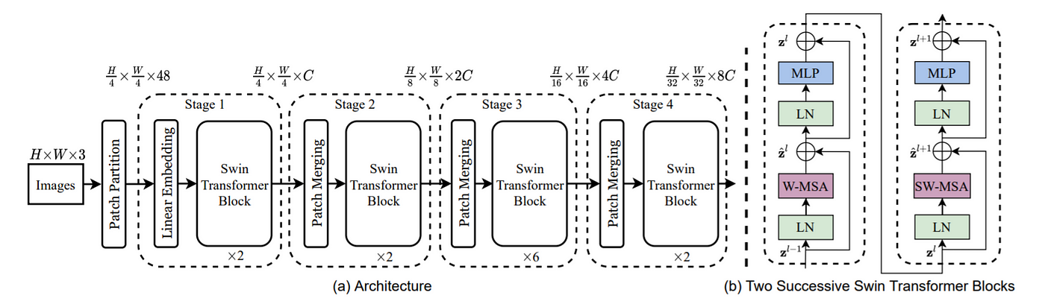

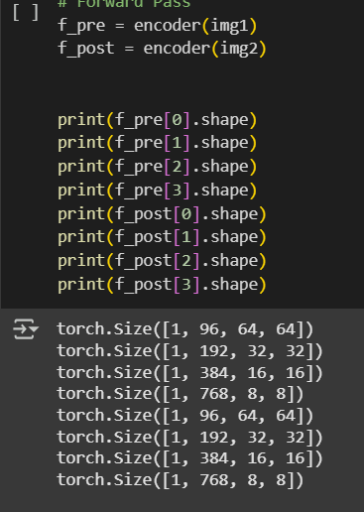
1
2
3
4
f_pre[0],
f_post[0]
f_pre[1],
f_post[1]
f_pre[2],
f_post[2]
f_pre[3],
f_post[3]
H=256, W=256
C=96
patch_size=4
Window_size= 8patches
Liu, Z., Lin, Y., Cao, Y., Hu, H., Wei, Y., Zhang, Z., Lin, S., Guo, B. (2021). Swin Transformer: Hierarchical Vision Transformer using Shifted Windows. arXiv preprint arXiv:2103.14030.

Slide 9
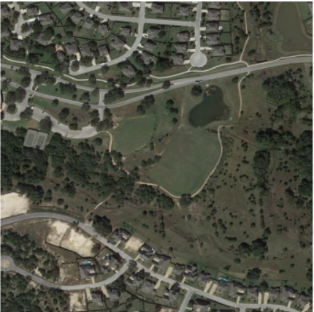


WINDOW-MSA
Self-attention is computed independently within each 8×8 window — i.e., tokens (pixels or patches) in one window do not interact with those in other windows during that attention computation.
Computationally Fast
Give Local attention
Window
Patch

Slide 10
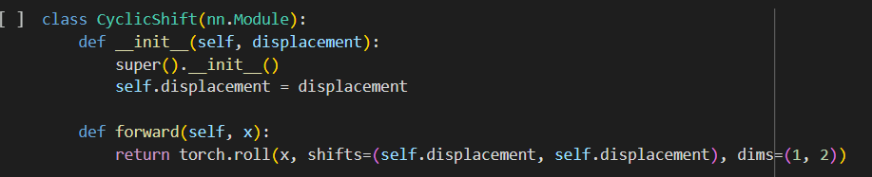
SHIFTED-WINDOW-MSA
A pixel that was previously at the boundary of a window now gets grouped with some pixels from a neighboring window.
Thus, we get attention across old window boundaries thus introducing global attention.

Slide 11
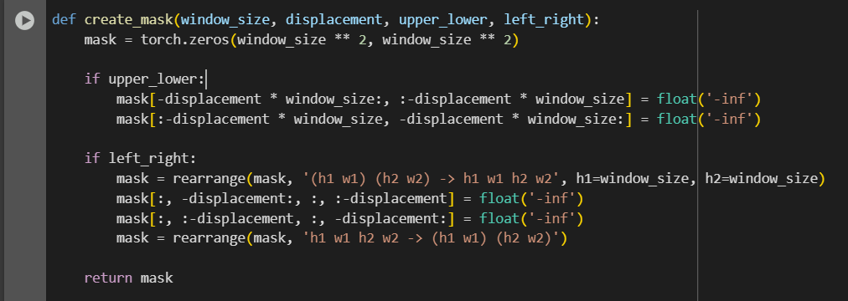
Masked-MSA
The cyclic shift mixes pixels from adjacent windows.
Now some windows contain pixels from two adjacent original windows → enables cross-window interaction.
Some pairs of pixels in the shifted window were far apart in the original layout. Those should not attend.

Slide 12
Decoder
Pre-Change
}
4Cebd
Cebd
}
Cebd
Cebd
}
}
Cebd
MLP
BLOCK
}
Cebd
UPSAMPLE
BLOCK
}
MLP
BLOCK
UPSAMPLE
BLOCK
CLASSIFIER
H/32
H/16
H/8
H/4
H/4
H/4
H * W * Cebd
H/32*W/32 *768
H/4 *W/4 *96
H/8 *W/8 *192
H/16 *W/16 *384
Post-Change

Slide 13
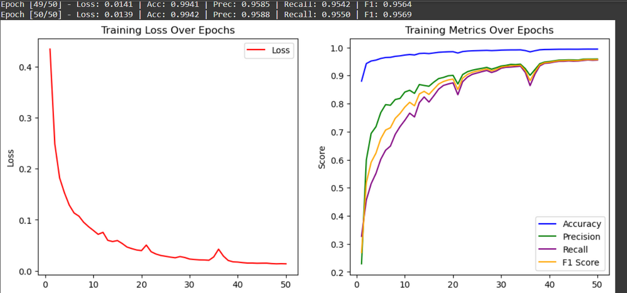
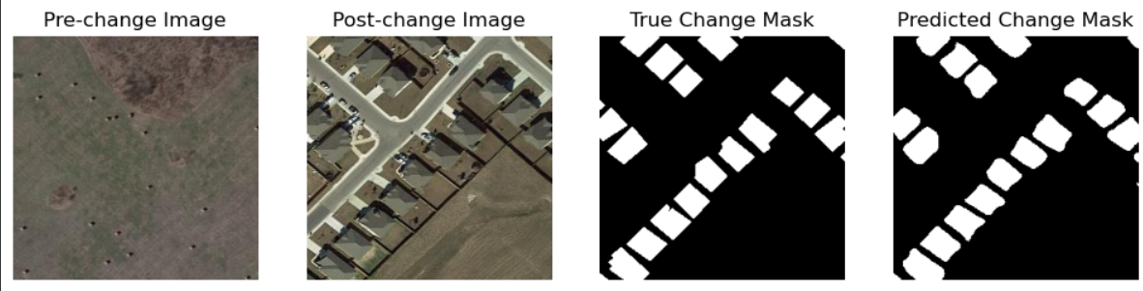
RESULTS
Swin -Transformer DataSize(1/16)

Slide 14
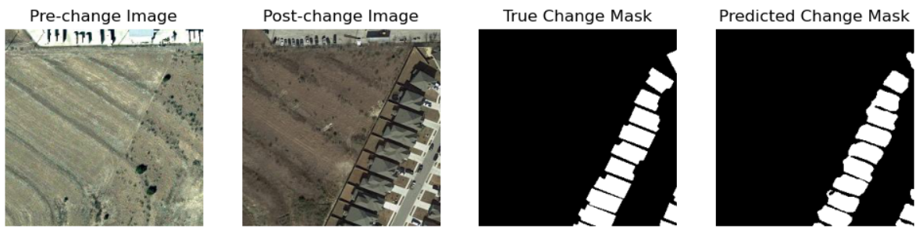
Swin -Transformer DataSize(1/4)

Slide 15
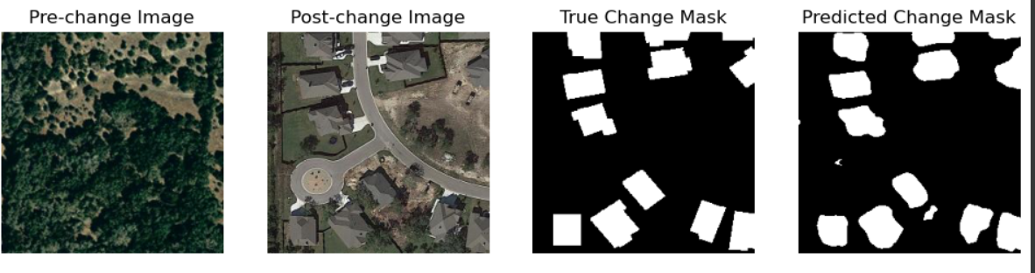
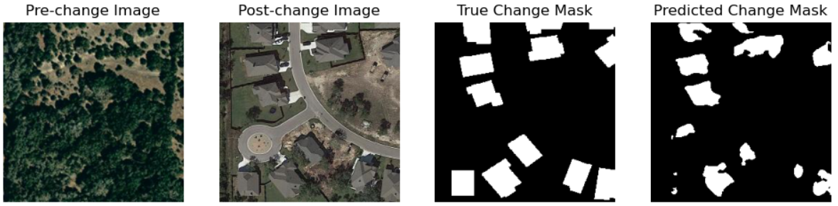
A COMPARISON
Swin -Transformer DataSize(1/4)
Vision-Transformer DataSize(1/4)

Slide 16
ACCURACY MATRIX
MODEL | ACCURACY | PRECISION | RECALL | F1 SCORE
VIT DATASIZE 1/16 | 92.36 | 51.47 | 48.96 | 50.18
VIT DATASIZE 1/4 | 97.55 | 74.43 | 65.11 | 69.46
SWIN DATASIZE 1/16 | 96.87 | 78.71 | 61.91 | 69.31
SWIN DATASIZE 1/4 | 98.74 | 85.31 | 85.24 | 85.27

Slide 17
CONCLUSION
HIERARCHICAL VISION TRANSFORMER
Learns multi-scale features via a custom patch-based hierarchical encoder
Uses global self-attention, enabling full-image context modeling at each level
Strong performance on large datasets and tasks requiring global reasoning
Higher computational cost due to global attention at all stages
HIERARCHICAL SWIN TRANSFORMER
Also hierarchical, but uses shifted window-based local attention
Efficient modeling of both local and global context with linear scalability
Shifted windows introduce local inductive bias while allowing cross-window interaction
Balances performance and computation, even on high-resolution images

Slide 18
Liu, Z., Lin, Y., Cao, Y., Hu, H., Wei, Y., Zhang, Z., Lin, S., Guo, B. (2021). Swin Transformer: Hierarchical Vision Transformer using Shifted Windows. arXiv preprint arXiv:2103.14030.
W. G. C. Bandara and V. M. Patel, "A Transformer-Based Siamese Network for Change Detection," IGARSS 2022 - 2022 IEEE International Geoscience and Remote Sensing Symposium, Kuala Lumpur, Malaysia, 2022, pp. 207-210, doi: 10.1109/IGARSS46834.2022.9883686.
R. Caye Daudt, B. Le Saux and A. Boulch, "Fully Convolutional Siamese Networks for Change Detection," 2018 25th IEEE International Conference on Image Processing (ICIP), Athens, Greece, 2018, pp. 4063-4067, doi: 10.1109/ICIP.2018.8451652
Dosovitskiy, A., Beyer, L., Kolesnikov, A., Weissenborn, D., Zhai, X., Unterthiner, T., Dehghani, M., Minderer, M., Heigold, G., Gelly, S., Uszkoreit, J., Houlsby, N. (2020). An Image is Worth 16x16 Words: Transformers for Image Recognition at Scale. arXiv preprint arXiv:2010.11929.
Understanding Deep Learning by Simon J.D. Prince
Youtube Video Explaination of Swin Transformer
REFERENCES
Youtube Video for understanding Vision Transformer

